Slide 1
CS 408
Computer Networks
TCP Traffic Control (from Chapter 07)

Slide 2
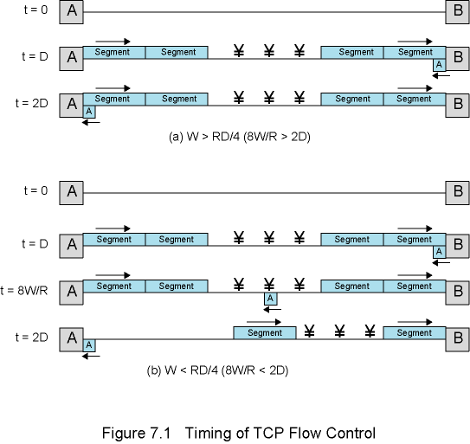
Figure 7.1 - Timing of TCP Flow Control
(A Very Simplistic Model)
. . . . .
. . . . .
. . . . .
. . . . .
. . . . .
Notes:
Protocols and the TCP/IP Suite
Chapter 2

Slide 3
Effect of Window Size
W = TCP window size (octets)
R = Data rate (bps) at TCP source
D = End to end delay (except the transmission delay at source) (seconds)
  The delay between starting the first bit at source and reception at the destination
After TCP source begins transmitting, it takes D seconds for first octet to arrive, and D seconds for acknowledgement to return
TCP source could transmit at most 2RD bits, or RD/4 octets, if W permits
In this simplistic model, D does not include the transmission time of the first packet but it is ignored as D is relatively larger than the per packet transmission time

Slide 4
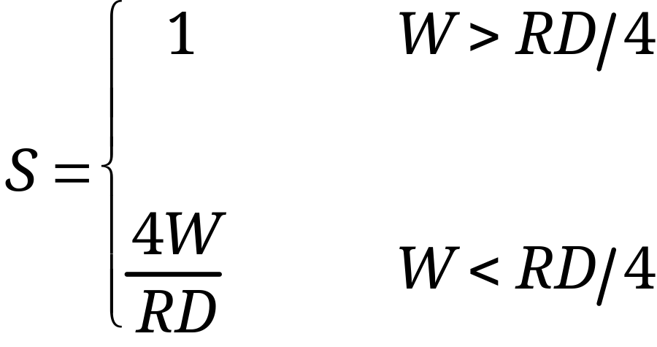
TCP Utilization (Very Simplistic)
U

Slide 5
Complicating Factors
Multiple TCP connections multiplexed over the same network interface
  Reducing R
For multi-hop connections, D is sum of delays across each network plus delays at each router
If source data rate R exceeds data rate on a hop, that hop will be a bottleneck and will increase D
Lost segments retransmitted, reducing throughput
  Impact depends on retransmission strategy (will see next)

Slide 6
Retransmission Strategy
TCP relies on positive acknowledgements
  Retransmission on timeout
Timer associated with each segment starts as it is sent
If timer expires before acknowledgement, sender must retransmit
Value of retransmission timer is a key factor
  Too small: many unnecessary retransmissions, wasting network bandwidth
  Too large: delay in handling lost segments
  Timer should be longer than round-trip delay, but this delay is variable

Slide 7
Two Strategies
Fixed timer
  Unable to respond changing network conditions
Adaptive
  Timer value changes as network conditions change
  TCP uses adaptive timer

Slide 8
Problems with Adaptive Scheme
Peer TCP entity may accumulate acknowledgements and may not acknowledge immediately.
For retransmitted segments, cannot tell whether acknowledgement is response to original transmission or to retransmission.
The problem is the same: difficulty in calculating the round-trip time and timeout value
  Actually no perfect solution exists, but there are standard heuristic approaches as will be detailed next

Slide 9
Adaptive Retransmission Timer Management
2 sub-problems
  Estimate the next round trip time (RTT) by observing pattern of delay
  Determine the timeout value by setting a bit greater than this estimate
Simple average
  average the observed RTTs over a number of segments
Exponential average
  later segments have more weight

Slide 10
RFC 793 Exponential Averaging
Smoothed Round-Trip Time (SRTT) – Estimated one
RTT is the observed one (i.e. measured time between sending a segment and receiving its acknowledgment)
SRTT(K+1) = α*SRTT(K)+(1–α)*RTT(K+1)
SRTT(K+1) is estimate for (K+2)^{nd} round-trip time and SRTT(0)= 0
Gives greater weight to more recent values as shown by expansion of above:
SRTT(K+1) =(1–α)RTT(K+1) + α(1–α)RTT(K) +
α²(1–α)RTT(K–1) + … + α^{K}(1–α)RTT(1)
α and 1–α < 1, so successive terms get smaller
For example, when α = 0.8
SRTT(K+1)=0.2 RTT(K+1)+0.16 RTT(K)+ 0.128 RTT(K–1) + ...
Smaller values of α give greater weight to recent RTT values

Slide 11
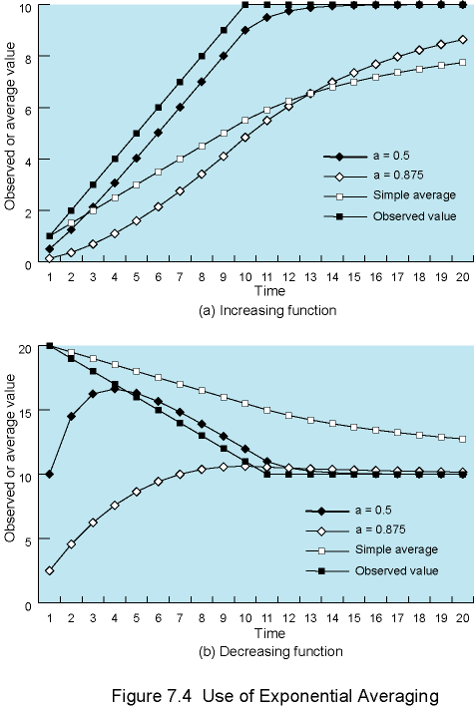
Use of Exponential Averaging – Increasing observed RTT
The legends in Figure 7.4 of the book are wrong! The figure here is correct

Slide 12
Use of Exponential Averaging – Decreasing observed RTT

Slide 13
How to determine RTO
RTO means Retransmission TimeOut
  Also known as Retransmission Timer
Two basic approaches
  Add fixed Δ to estimated RTT
  RTO(K+1) = SRTT(K+1) + Δ
  Multiply estimated SRTT with a fixed factor greater than 1
Both not good if the observed RTT has variation
It is better if the RTO depends on the estimated SRTT and standard deviation in SRTT
  Jacobson’s method/algorithm

Slide 14
RTT Variance Estimation
(Jacobson’s Algorithm)
Standard method
RTT may show high variance. Possible reasons:
  Variance in packet size may cause variance in transmission delays
  Network traffic load may change abruptly due to other sources
  Peer may not acknowledge segments immediately

Slide 15
Jacobson’s Algorithm
SRTT(K + 1) = (1 – g) × SRTT(K) + g × RTT(K + 1)
  This is the estimated RTT for K+2nd segment
SERR(K + 1) = RTT(K + 1) – SRTT(K)
SDEV(K + 1) = (1 – h) × SDEV(K) + h ×|SERR(K + 1)|
  This is the standard deviation that will be used for the timeout value for K+2nd segment
RTO(K + 1) = SRTT(K + 1) + f × SDEV(K + 1)
  This is the timeout value for K+2nd segment
Based on experiments
  g = 0.125
  h = 0.25
  f = 2 or f = 4 (most current implementations use f = 4)
  Note that in previous slides we used α instead of 1-g and used 1-α instead of g

Slide 16
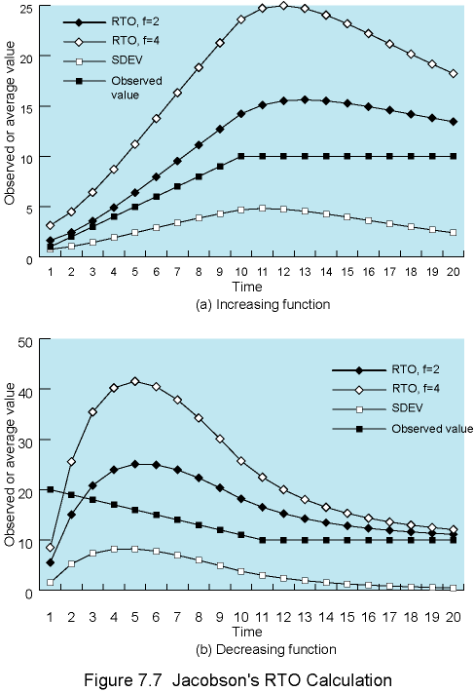
Jacobson’s
RTO
Calculation
RTO is quite conservative while RTT is changing
Then begins to converge

Slide 17
Two Other Factors
Jacobson’s algorithm is a good method for determining RTO, but:
What RTO to use for retransmitted segments?
  ANSWER: exponential RTO backoff algorithm
Which round-trip samples to use as input to Jacobson’s algorithm if a segment is retransmitted?
  ANSWER: Karn’s algorithm

Slide 18
Exponential RTO Backoff
Since timeout is probably due to congestion (dropped packet or long round trip delay), maintaining the same RTO is not good idea for a retransmitted segment
RTO increases each time a segment is
re-transmitted → backoff process
  RTO_{i+1} = q*RTO_{i}
  exponential backoff; RTO for a retransmission is the multiplication of RTO of previous (re)transmission of the same segment and q.
Most commonly q = 2
  binary exponential backoff

Slide 19
Which Round-trip Samples?
If a segment is retransmitted, the ACK arriving may be:
  For the first copy of the segment?
  For the second copy?
TCP source cannot distinguish between these two cases
  wrong assumptions may yield wrong results and estimates
Karn’s rules
  Do not measure RTT for retransmitted segments to update SRTT and SDEV
  Calculate backoff RTO when re-transmission occurs
  Use backoff RTO until ACK arrives for segment that has not been re-transmitted
When ACK is received for an un-retransmitted segment (i.e. for a segment sent and its ack is received without retransmission), Jacobson algorithm resumes to calculate future RTO values

Slide 20
TCP Window Management
Remember that in TCP, source is given some credits to send segments (called the window)
  But this mechanism itself is not sufficient for a proper congestion avoidance and control
There are some TCP window management mechanisms to avoid congestion
Slow start
Dynamic window sizing on congestion
Fast retransmit
Fast recovery
Notes:
Protocols and the TCP/IP Suite
Chapter 2

Slide 21
Slow start
It is not a good idea to start with a large window since the network situation is not known
Start connection with a small window, called congestion window (cwnd )
  initially one segment only
Enlarge congestion window at each ACK
  Add one segment to congestion window for each ack received
  Up to a certain max value, which is the available credit (window)
Actually not a slow procedure
  Congestion window growth is exponential

Slide 22
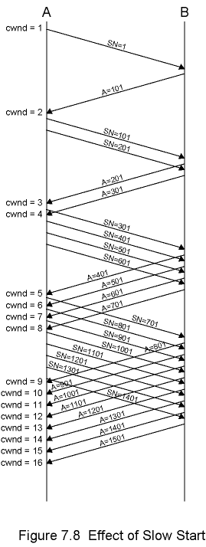
Effect of
Slow Start
Assume segment length is 100 octets

Slide 23
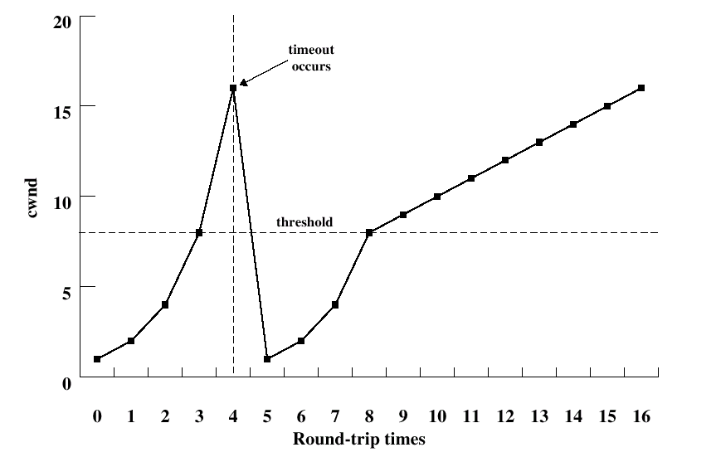
Dynamic windows sizing on congestion
When a timeout occurs
  Run slow start until the threshold
    threshold = half of the current congestion window at which timeout occurred.
    Increasing cong. window size by 1 segment for every ACK
  After threshold, increase congestion window by one segment for each RTT
    linear increase in window size
“Easy to drive a network into saturation but hard for the net to recover” (Jacobson)

Slide 24
Fast Retransmit
In general, RTO is noticeably longer than actual RTT
If a segment is lost, TCP may be slow to retransmit
TCP rule: if a segment is received out of order, an ack must be issued immediately for the last in-order segment
  TCP receiver continues to send the same ACK for each incoming segment until the missing one arrives
  After that, all incoming segments are ACKed.
Fast Retransmit rule: if 4 acks received for same segment, highly likely it was lost, so retransmit immediately, rather than waiting for timeout

Slide 25
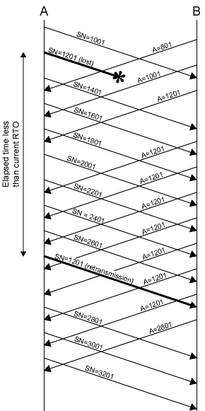
Fast Retransmit
Example
Segment length is 200 octets

Slide 26
Fast Recovery
When TCP retransmits a segment using Fast Retransmit, a segment was assumed lost
Congestion avoidance measures are appropriate at this point
  e.g., slow-start from cwnd=1
This may be unnecessarily conservative since multiple acks indicate segments are getting through
So Fast Recovery rules are applied
  retransmit lost segment
  cut cwnd in half
  proceed with incrementing the congestion window size by adding 1 segment for each ACK received
This avoids initial exponential slow-start

Slide 27
TCP Congestion Control
Dynamic routing can reduce congestion by spreading load more evenly
But only effective for congestion due to unbalanced loads and brief surges in traffic
Congestion can ultimately be controlled by limiting total amount of data entering network
IP is connectionless, with little provision for detecting or controlling congestion
  ICMP source Quench message is crude and not so effective
  RSVP may help but not widely used for all users/applications

Slide 28
TCP Flow and Congestion Control - Implicit
The rate at which a TCP entity can transmit is determined by rate of incoming ACKs to previous segments with new credit
Rate of ACK/credit arrival determined by the bottleneck in the round-trip path between source and destination
  Bottleneck may be destination or Internet
  See next slide for a visual explanation

Slide 29
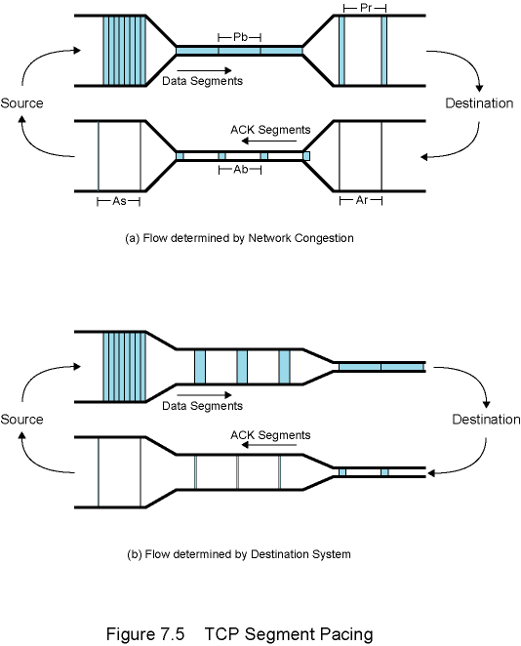
TCP Segment
Pacing
Heights of the pipes represent capacity
Pb = Pr = Ar = Ab = As
Steady state: sender’s segment rate is equal to the slowest line on the round trip path
TCP’s self-clocking behavior
  TCP automatically senses the network bottleneck
  However cannot say whether the bottleneck is at destination or at network

Slide 30
Moral of the story
If the bottleneck is at physical layer and consistent, then TCP finds its optimal capacity in the steady state
However, if the delay is due to fluctuating queuing effects, then the system may not achieve steady state without intervention
There will be delays and queues
  No way out!
TCP flow should be arranged accordingly
  If too slow, system underutilized
  If fast, congestion
  TCP sliding window mechanism should react to congestion effectively
    That is why we have RTT & RTO estimation mechanisms, slow start, dynamic window sizing and other window management mechanisms

Slide 31
Explicit Congestion Notification (ECN)
Defined in RFC 3168 (not native in TCP and IP protocols)
Routers alert end systems about growing congestion
  End systems take precautions to reduce load
ECN prevents packet drops
  Alert end systems before congestion causes packet drop
  Retransmissions are avoided
Changes done to use ECN
  TCP and IP protocol implementations should provide support for ECN
  TCP entities enable ECN by negotiation at connection establishment time
  Two new bits are added to TCP header
  Two new bits are added to IP header

Slide 32
IP Header
Originally
  IPv4 header includes 8-bit Type of Service field
  IPv6 header includes 8-bit Traffic Class field
Later this field is reallocated
  Leftmost 6 bits dedicated to DS (differentiated services) field,
  Rightmost 2 bits was unused
RFC 3260 renames these unused bits as ECN field
Interpretations of the ECN field:
  Value Label Meaning
  00 Not-ECT Packet is not using ECN
  01 ECT (1)
  10 ECT (0)
  11 CE Congestion experienced
Set by the sender to indicate ECN-capable transport

Slide 33
TCP Header
To support ECN, two new flag bits added
ECN-Echo (ECE) flag
  Used by receiver to inform sender when CE packet has been received
Congestion Window Reduced (CWR) flag
  Used by sender to inform receiver that sender's congestion window has been reduced
These two bits are also used in connection establishment to enable end points to agree to use ECN (next slide)

Slide 34
TCP Initialization
TCP header bits are also used in connection establishment to enable end points to agree to use ECN
A sends SYN segment to B with ECE and CWR set
  Meaning that A is ECN-capable and prepared to use ECN as both sender and receiver
If B is prepared to use ECN, returns SYN-ACK segment with ECE set CWR not set
If B is not prepared to use ECN, returns SYN-ACK segment with ECE and CWR not set

Slide 35
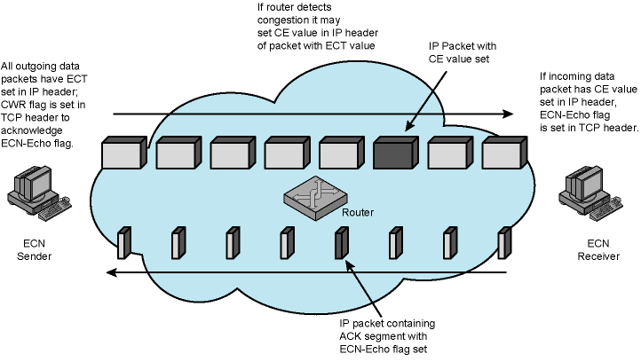
Basic ECN Operation

Slide 36
The End
Final Exam is on December 26, 2019, Thursday, at 12:30
  Last name initials: [A-D] in FENS L045
  [E-Ş] in FENS G077 (auditorium)
  [T-Z] in FENS G035
  Closed book, closed notes, closed etc. Calculators are OK, no laptops
  Comprehensive, but the topics covered after midterm may have more weight.
  More details are sent with email.
The quiz for Lab 4 will be done together with the final exam
  The quiz (only the quiz) will be open notes.
I put handouts from other books to SUCourse.
There will be an extra recitation (to be delivered by myself) on December 25, Wednesday, 19:00 – 21:00 in FENS L045
  I've already sent the questions to be solved in this recitation
  But the answers will not be sent (before or after the recitation)
Good Luck!

